Slide 1
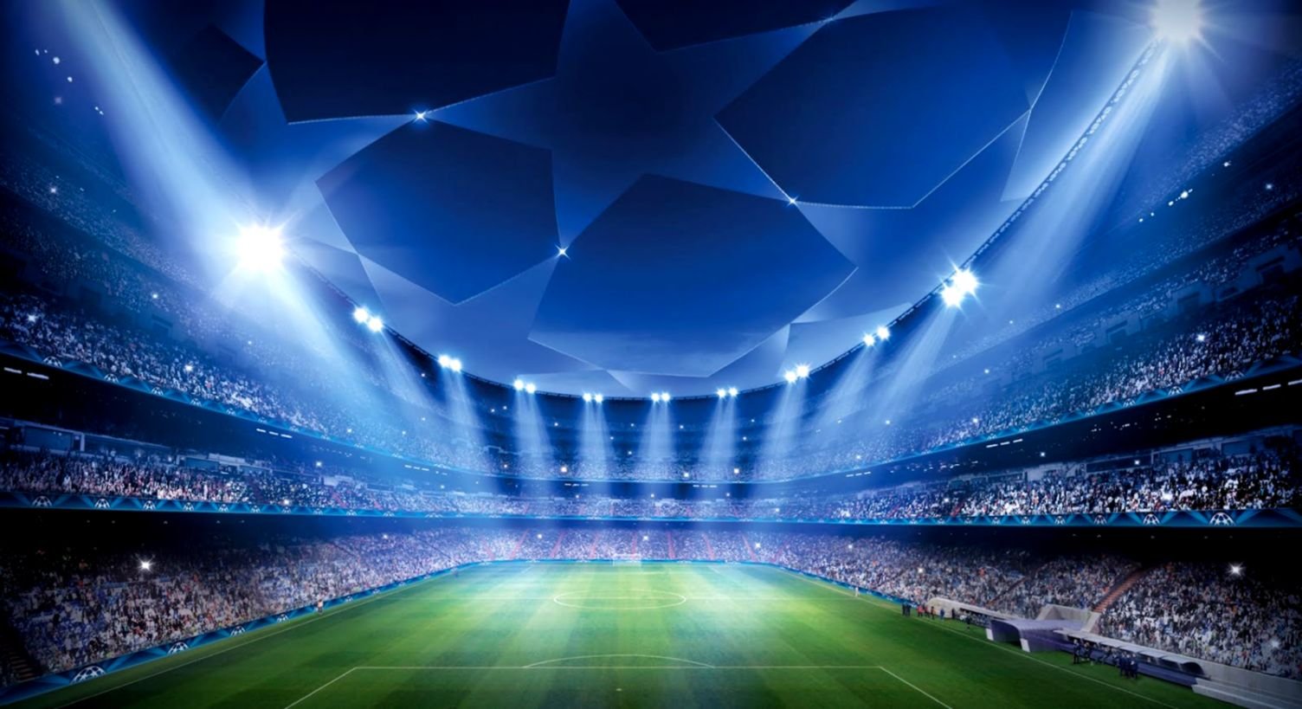

UEFA Champions league
Who will be the next winner?

Slide 2
UEFA Champions league
Was made by:
Elad Itzhak (ID 201414283) && Avishai Nudelman (ID 300012614)

Slide 3
Why?
UEFA Champions league
Since we are big football fans and this is the biggest competition exist (for clubs).
We also love from time to time to gamble and fill ‘Winner’ forms.

Slide 4
Goals
UEFA Champions league
Use ‘Machine Learning’ to predict who is going to be the ’2018/2019 Champions League’ big winner.
Predict the outcome of individual matches for the knockout part of the competition.
Run simulation of the next matches i.e quarter finals, semi finals -and finals.

Slide 5
Data sources
UEFA Champions league
All games - https://github.com/footballcsv/europe-champions-league
Assisting code - https://github.com/itsmuriuki/FIFA-2018-World-cup-predictions/blob/master/Predicting%20Fifa%202018.ipynb

Slide 6
DATA
UEFA Champions league
Originally the data contained all the ‘Champions League’ games since 1955.
Since many of the leading teams back then are not relevant anymore, we dropped the games that took place before 1990.
In addition, we dropped few columns that we didn’t find relevant and the data was adjusted so it will be useable by the algorithm.
This years dataset was created manually.

Slide 7
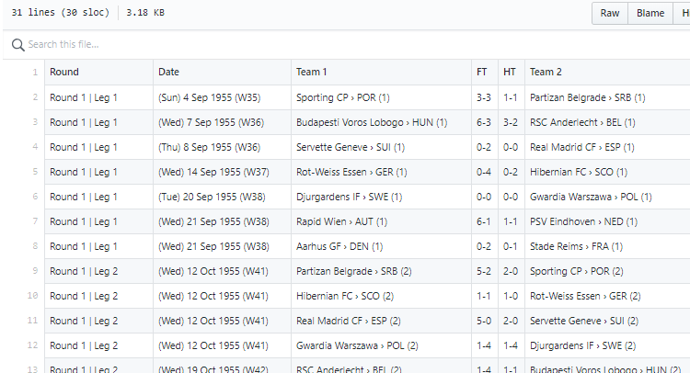
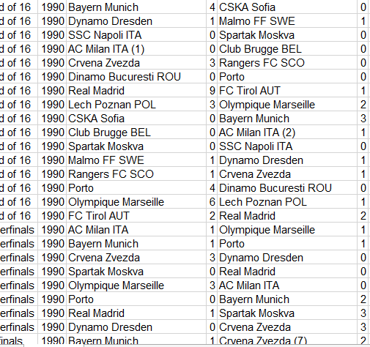
DATA
UEFA Champions league

Slide 8
Methodology
UEFA Champions league
After a research we made we found that the most suitable methodology for our project will be using “Logistic-Regression”, which is a statistical model that links between different attributes to the outcome.

Slide 9
How it works
UEFA Champions league
The script first runs the training set on the algorithm and in accordance to it attributes and outcome the coefficients is bring set.
After the training and test sets run, the algorithm is being executed on the data we are exploring in order to get the required prediction.

Slide 10
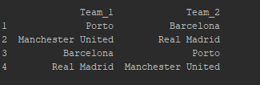
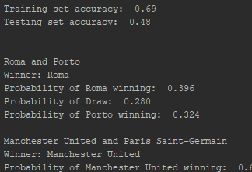
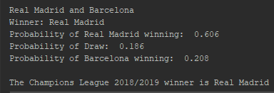
Outcomes
UEFA Champions league

Slide 11
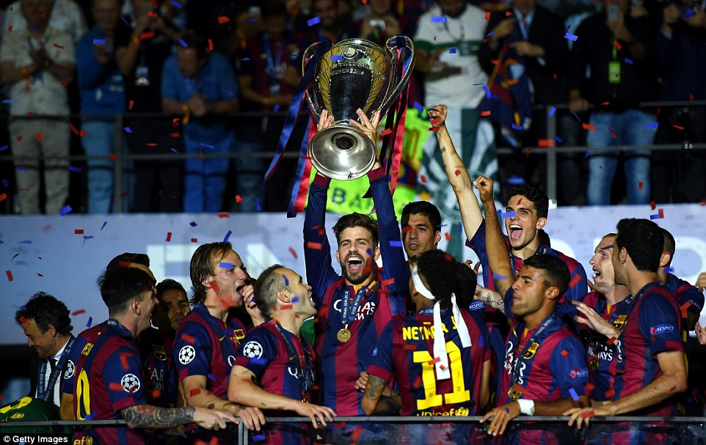

Outcomes
UEFA Champions league
Since there is a random aspect, we wrote a script which runs first script hundres times. The team who won the most was…..

Slide 12
Outcome analyze
UEFA Champions league
After running the program 100 times the outcomes we got are pretty logic as Barcelona, Real Madrid and Bayern Munich had won most times.
It seems especially logic since it doesn’t consider this days situation but only based on the last 28 years results.
Nevertheless, it seems to be almost impossible mission to predict such thing as tournament winner in football, especially since it’s a 90 minutes game and everything can happened and affect the outcomes. For example…

Slide 13
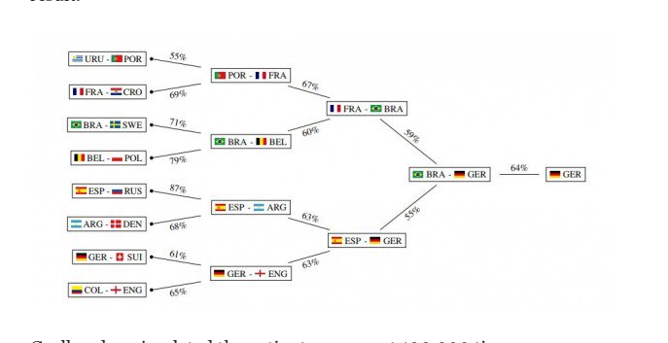
UEFA Champions league
Outcome analyze
MIT’s ML 2018 World Cup prediction:
https://www.technologyreview.com/s/611397/machine-learning-predicts-world-cup-winner/

Slide 14
Outcome analyze
UEFA Champions league
For those of you who don’t know – Germany lost to Mexico and South Korea in the groups stage and did qualify to the last 16 round.

Slide 15
Conclusions
UEFA Champions league
We have found that it is nearly impossible to predict football results correctly, but nonetheless we think there is a way that football gamblers can use an application that will exploit the odds the algorithm gives for each result in order to calculate which football bets are better for them than other.

